Slide 1
Streaming Machine Learning (SML)
Alessio Bernardo & Emanuele Della Valle
05-06-2021
Copyright © 2021 Quantia Consulting, srl. All rights reserved.

Slide 2

About me
Alessio Bernardo
Ph.D. Student in Data Science:
Politecnico di Milano
Research on Streaming Machine Learning
M.Sc. & B.Sc. Computer Engineering:
Politecnico di Milano
05-07-2021
Alessio Bernardo & Emanuele Della Valle
Notes:
Presentazione

Slide 3
Part I
Introduction
Notes:
Introduzione

Slide 4
Credits
Albert Bifet DATA STREAM MINING 2020-2021 course at Telecom Paris
Alessio Bernardo & Emanuele Della Valle
05-07-2021
Alessio Bernardo & Emanuele Della Valle

Slide 5
Big Data Trend
05-07-2021
Alessio Bernardo & Emanuele Della Valle

Slide 6
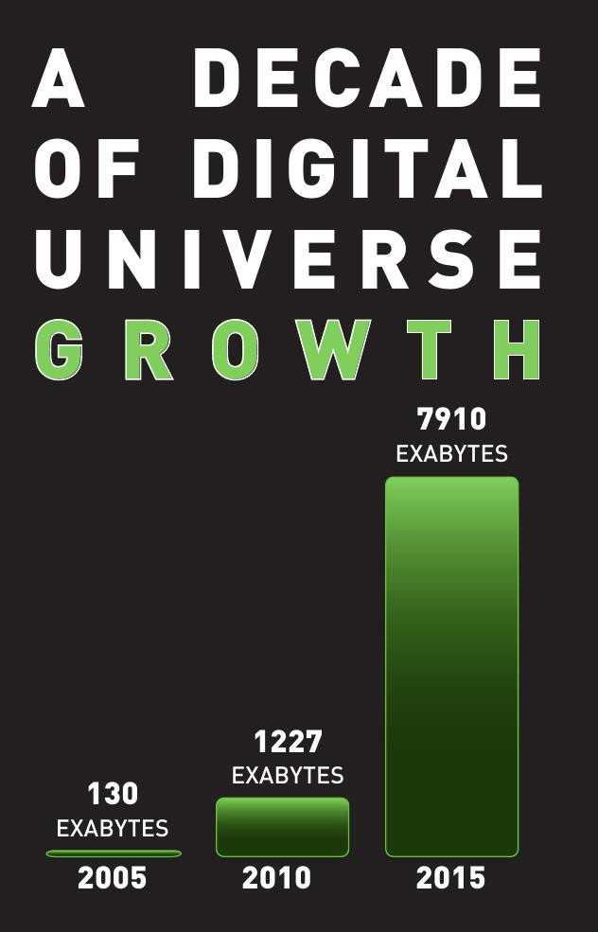
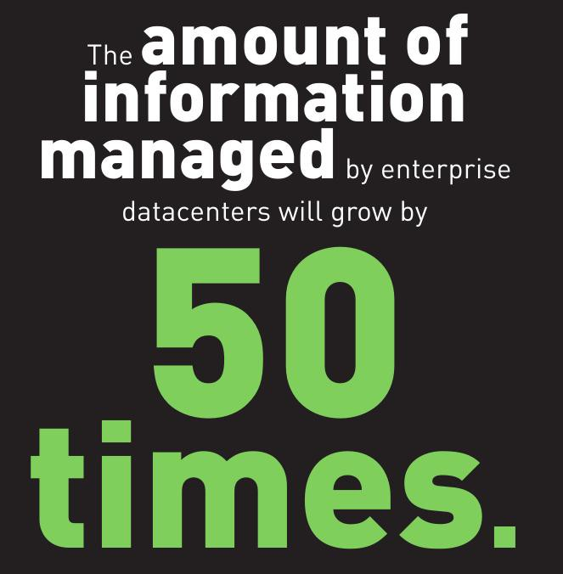
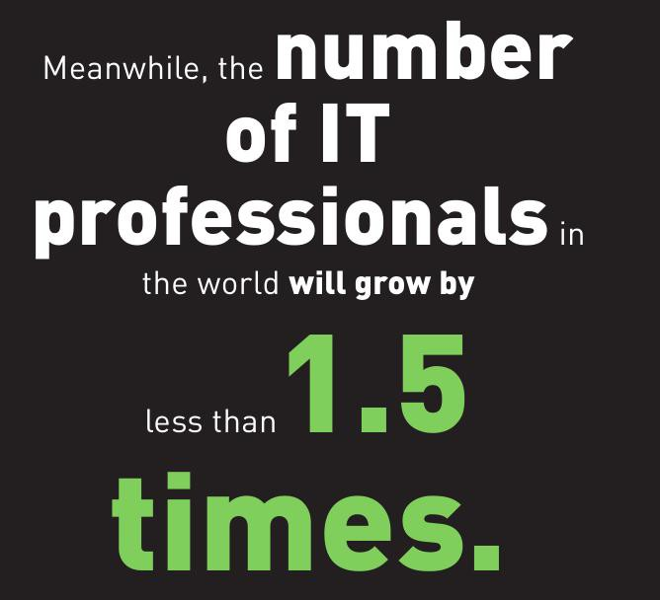
Big Data Trend
Source: IDC’s Digital Universe Study (EMC), June 2011
05-07-2021
Alessio Bernardo & Emanuele Della Valle

Slide 7
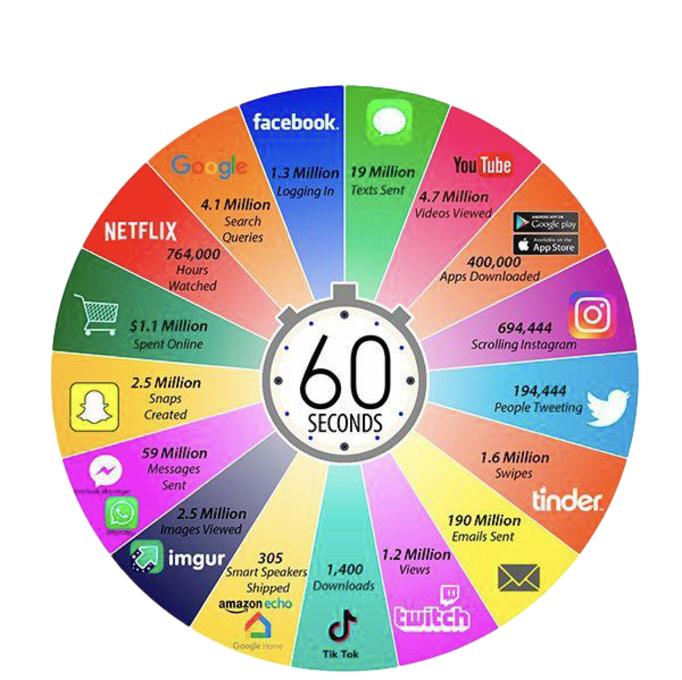
Big Data Trend
Source: @LoriLewis and @OfficiallyChadd
05-07-2021
Alessio Bernardo & Emanuele Della Valle

Slide 8
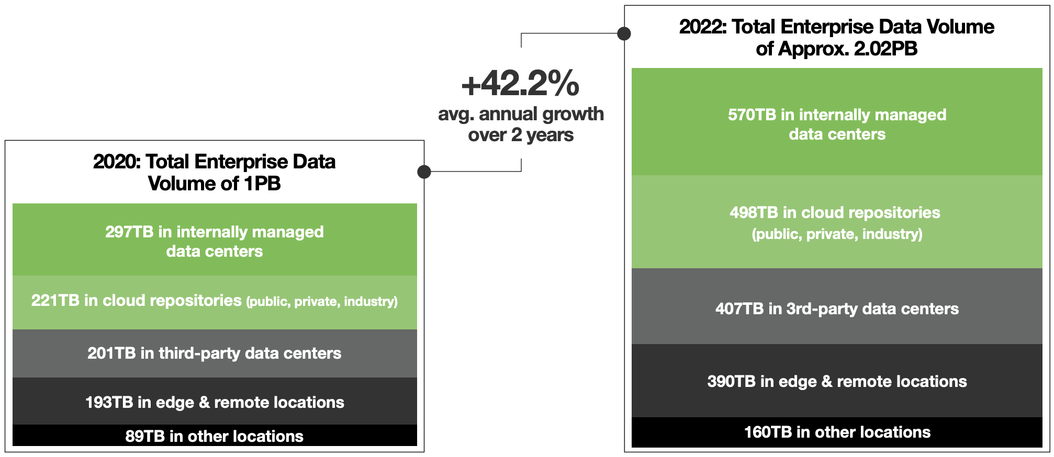
Big Data Trend
Source: SEAGATE TECHNOLOGY, June 2020
05-07-2021
Alessio Bernardo & Emanuele Della Valle

Slide 9
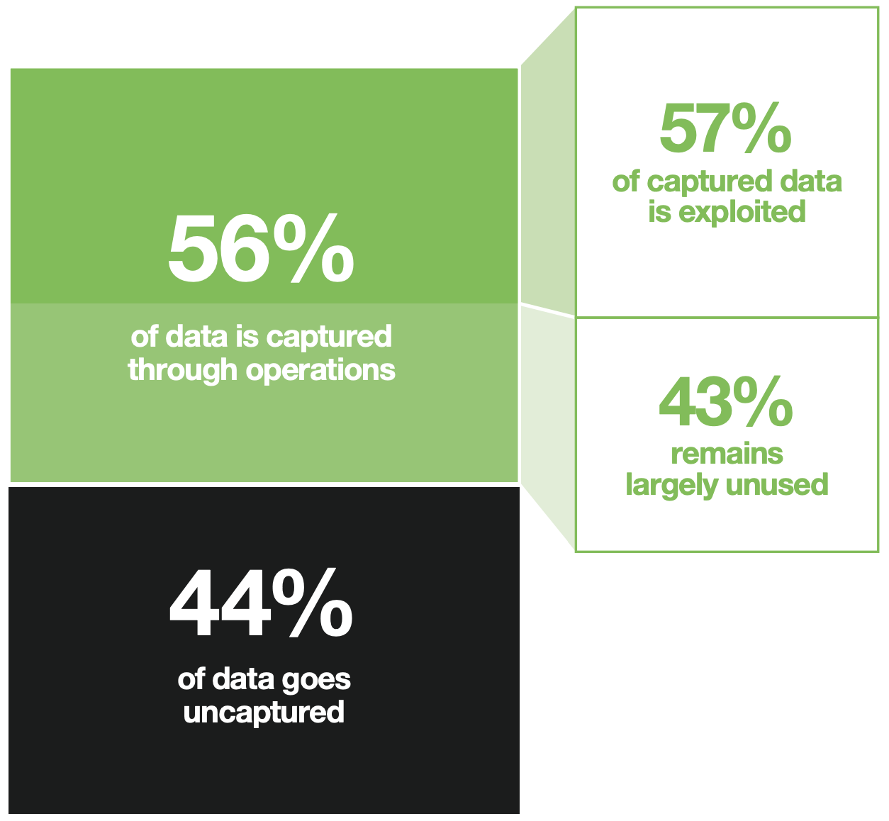
Big Data Trend
Source: SEAGATE TECHNOLOGY, June 2020
05-07-2021
Alessio Bernardo & Emanuele Della Valle

Slide 10
Data is growing, and the rate of growth is accelerating. The sum of data generated by 2025 is set to accelerate exponentially to 175 zettabytes, an order of magnitude bigger than the storage production capability.
Big Data Trend
Dave Mosley, CEO of SEAGATE TECHNOLOGY
05-07-2021
Alessio Bernardo & Emanuele Della Valle
Notes:
Definizione ricerca
Definizione formale di anomalia

Slide 11
Innovation is not driven by trends, but by the need to create more value under constraints. This exponential inflation will thus require analysing almost 30% of global data in real-time.
Big Data Trend
Dave Mosley, CEO of SEAGATE TECHNOLOGY
05-07-2021
Alessio Bernardo & Emanuele Della Valle
Notes:
Mem e time constraints

Slide 12
Batch vs Data Stream
05-07-2021
Alessio Bernardo & Emanuele Della Valle

Slide 13



Batch
Random access
to data
Well defined
training phase
X₀
X₁
X₂
No restrictions on memory/time for training
X₃
...
X_{n}
Access to all labeled
data used for training
05-07-2021
Alessio Bernardo & Emanuele Della Valle

Slide 14
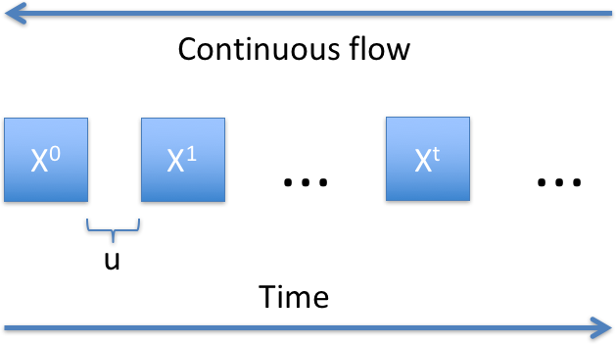
Data Stream
Continuous flow of data generated at high-speed in dynamic, time-changing environments.
Sequential
access only
Evolving data
Strict time/memory requirements
Characteristics of data seen so far
05-07-2021
Alessio Bernardo & Emanuele Della Valle

Slide 15
ML vs SML
05-07-2021
Alessio Bernardo & Emanuele Della Valle

Slide 16
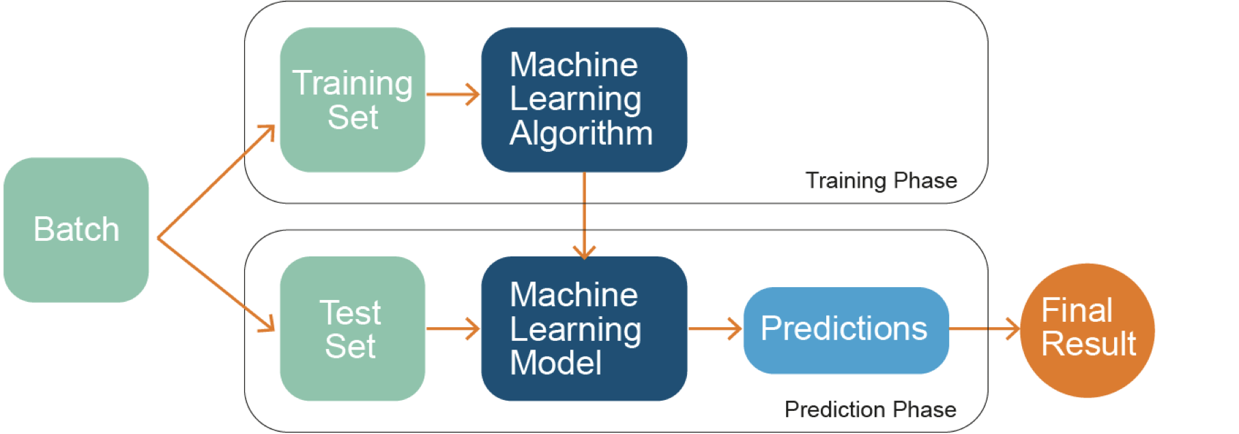
ML Models
05-07-2021
Alessio Bernardo & Emanuele Della Valle

Slide 17
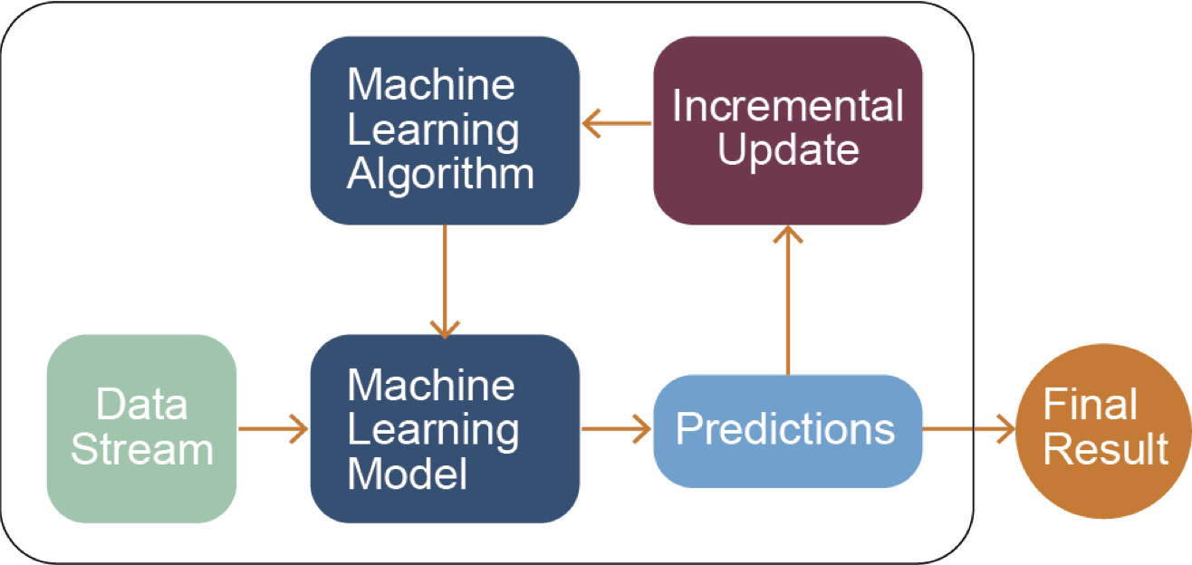
SML Models
05-07-2021
Alessio Bernardo & Emanuele Della Valle
Notes:
In particular, SML algorithms are able to continuously incorporate new data without retraining their models from scratch. Moreover, they firstly use the new sample in input to test the model and then to update it. This particular approach is called prequential evaluation and it solves the problem that the testing set is not available.

Slide 18
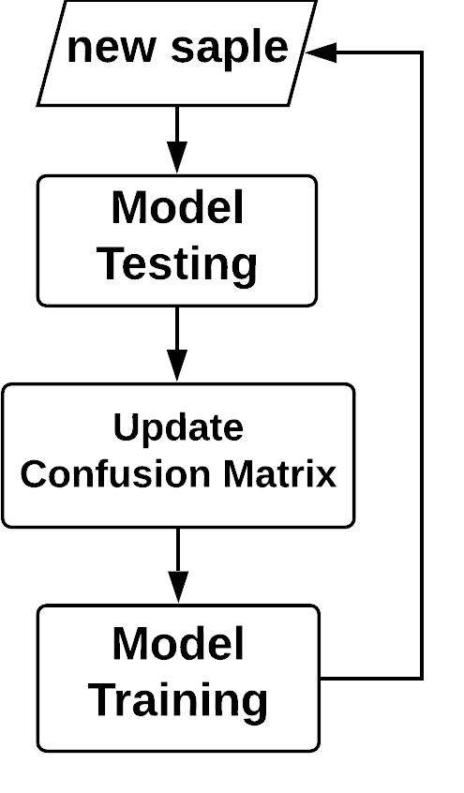

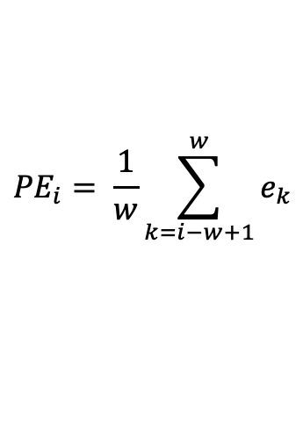
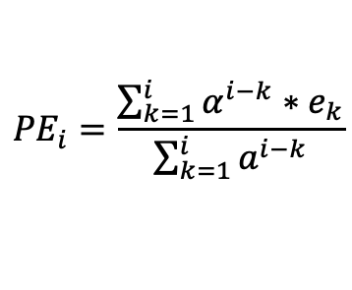
Prequential Evaluation
Estimate prequential error (PE):
Sliding window of size w
e₁
e₂
e₃
e₄
e₅
$${PE}_{i}= \frac{1}{w}\sum_{k=i−w+1}^{w}{e_{k}}$$
e₂
e₃
e₄
e₅
e₆
e₃
e₄
e₅
e₆
e₇
Fading factor
$${PE}_{i}=\frac{\sum_{k=1}^{i}{α^{i−k}{∗e}_{k}}}{\sum_{k=1}^{i}{a^{i−k}}}$$
with $0≪α ≤1$
Gama, J., Sebastião, R. and Rodrigues, P.P.: Issues in evaluation of stream learning algorithms. In ACM KDD, 2009.
05-07-2021
Alessio Bernardo & Emanuele Della Valle

Slide 19
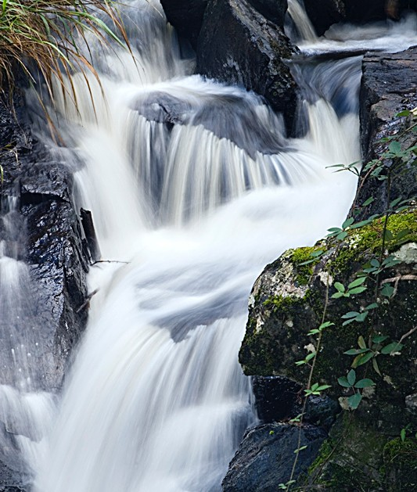
SML Models
Incorporate data on the fly
Unbounded training sets
Resource efficient
Dynamic models
05-07-2021
Alessio Bernardo & Emanuele Della Valle
Notes:
For these reasons, the SML was introduced. it is able to maintain models online that means:
We don’t have the entire data available, so an online model needs to incorporate one sample at a time. Moreover the stream is unbounded, so it must be able to update the model every time. It’s impossible to retrain the model from the beginning every new sample. Since the stream is unbounded, the model needs to manage the data in a proper way. It’s unfeasible to save all the samples arrived. In fact after the testing and the training phase the sample is discarded. Since the steam evolves in time, it can present some form of non stationary. An online model must be dynamic and adapt to it.
Dynamic: forgetting outdated information

Slide 20
Benefits
One sample at a time
Incremental models
Time and Memory management
05-07-2021
Alessio Bernardo & Emanuele Della Valle
Notes:
Non c’è bisogno di aspetare tutti I dati
Non devo ri-trainare un modello da capo ogni volta che ho dati nuovi/diversi

Slide 21
Challenges
Non-stationarity (Concept drift)
Class imbalance
Hyper-parameter Tuning
05-07-2021
Alessio Bernardo & Emanuele Della Valle

Slide 22
QUIZ
What are the data streams characteristics?
All data are available, non-stationary, bounded
One sample available at a time, non-stationary, unbounded
One sample available at a time, unbounded, access to old data
How do the SML models address the time and memory problem?
Updating the model with the new sample and then discarding it
Updating the model with the new sample and then saving it
Saving every time the new sample and retraining anew the model
05-07-2021
Alessio Bernardo & Emanuele Della Valle

Slide 23
QUIZ
What are the data streams characteristics?
All data are available, non-stationary, bounded
One sample available at a time, non-stationary, unbounded
One sample available at a time, unbounded, access to old data
How do the SML models address the time and memory problem?
Updating the model with the new sample and then discarding it
Updating the model with the new sample and then saving it
Saving every time the new sample and retraining anew the model
05-07-2021
Alessio Bernardo & Emanuele Della Valle

Slide 24
QUIZ
What are the data streams characteristics?
All data are available, non-stationary, bounded
One sample available at a time, non-stationary, unbounded
One sample available at a time, unbounded, access to old data
How do the SML models address the time and memory problem?
Updating the model with the new sample and then discarding it
Updating the model with the new sample and then saving it
Saving every time the new sample and retraining anew the model
05-07-2021
Alessio Bernardo & Emanuele Della Valle

Slide 25
EXERCISE 1: From batch to stream learning LAB 1: Prequential error
05-07-2021
Alessio Bernardo & Emanuele Della Valle
Notes:
Pandas, numpy, scikit-learn, matplotlib
Creare un dataset random
Creare un anomaly score banale
Visualizzare i risultati
Definizione di soglia arbitraria

